Slide 1
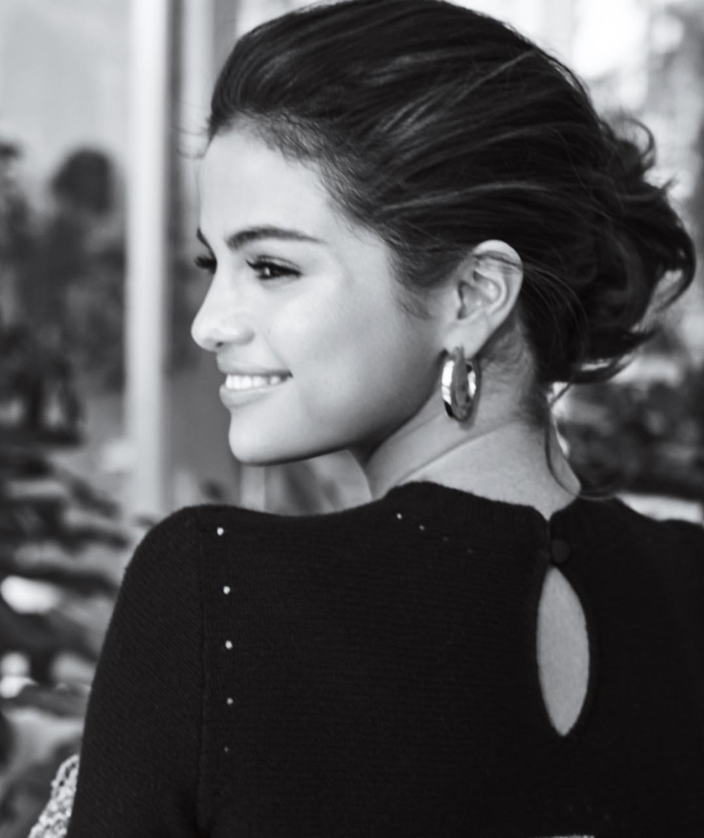
Selena Gomez
Featured Philanthropist

Slide 2
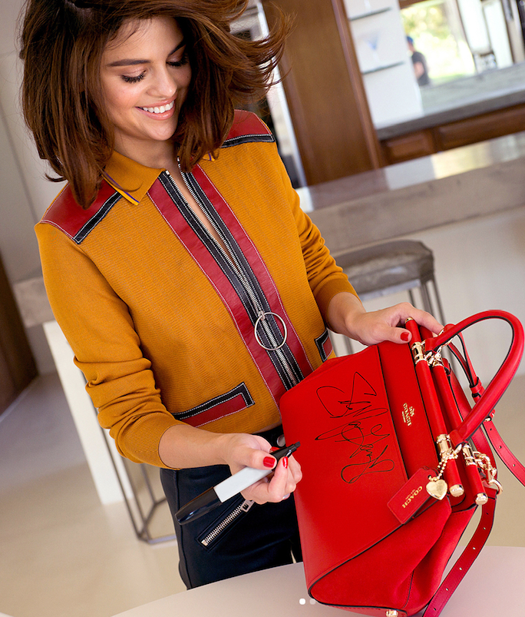

How She Gained Her Wealth
Selena Gomez has been on television since she got her breakout role on Barney when she was only seven years old.
According to Entity magazine there are 6 big ways in which Selena Gomez has accumulated her $50 million net worth at just 26 years old.
  1. She has sold millions of songs and albums around the world
  2. Her social media posts are worth $550,000 each
  3. She was the star on a hit Disney Channel Show growing up called Wizards of Waverly Place
  4. She’s made a lot of money from acting in several movies
  5. He has endorsement deals with large companies such as Coach, Puma, Coca-Cola, Pantene, and Louis Vuitton
  6. She has her own production company called July Moon Production which she started when she was only 16 years old

Slide 3
Core Values
One of the things Selena Gomez is admired for most is her dedication to her values and morals. She has stated on several occasions that her family, work ethic, and faith are three things that are most important to her and things she can’t compromise with.
In an interview with People magazine she discusses her values and her focus on mental health and recovery stating that “Strength doesn’t mean that you have to put on a facade. I think strength is being vulnerable. I hope my fans learn that who they are is beautiful [and] how they can connect with people by sharing what they’re feeling.”
A third value Selena holds very close to her is giving back which she talked about in her interview with Elle magazine for her October cover this year. She stated, "I’m grateful for my position and I will always find ways to make my job more about others and giving back -- all while having the best time with my music, fashion, film and my love for learning about the world that I’m eager to tap into more and more.”

Slide 4
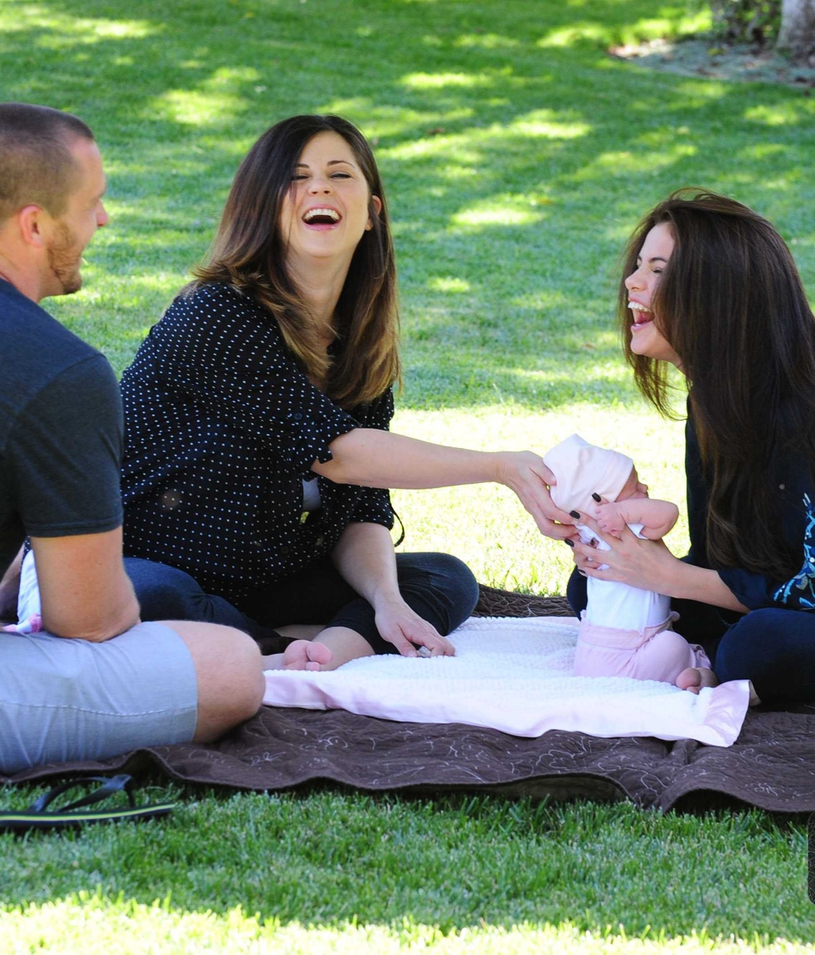
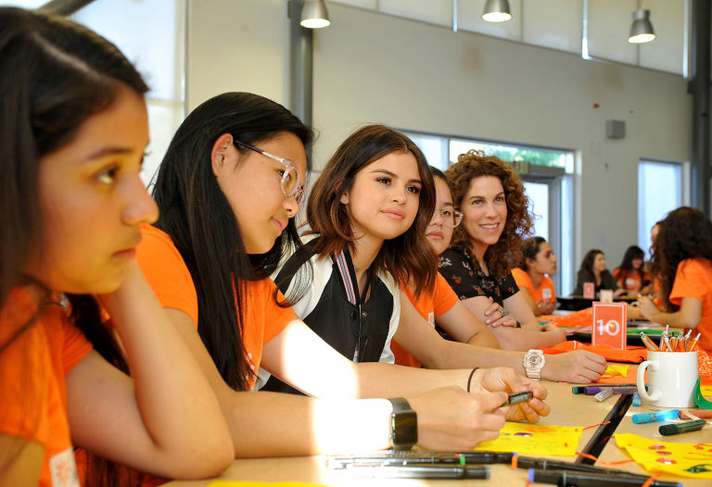
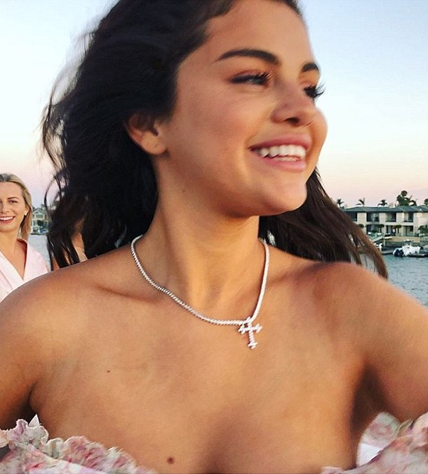
Giving Back
Family
Faith

Slide 5
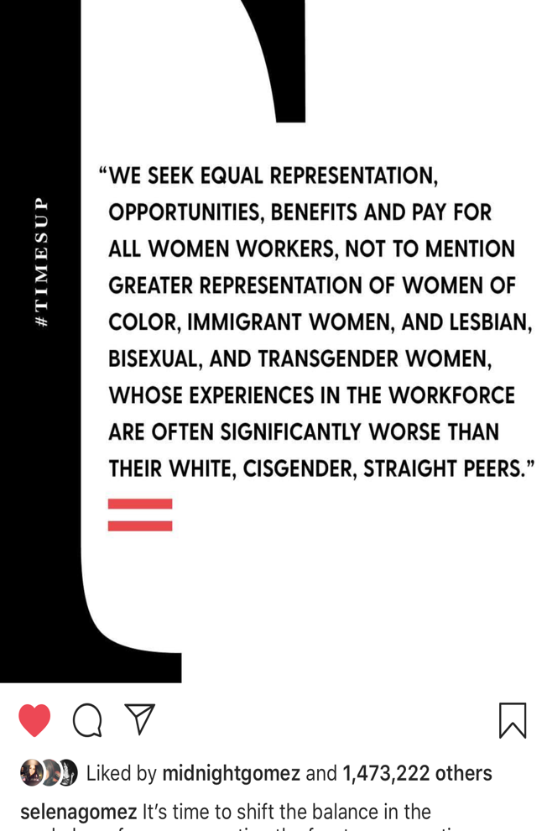
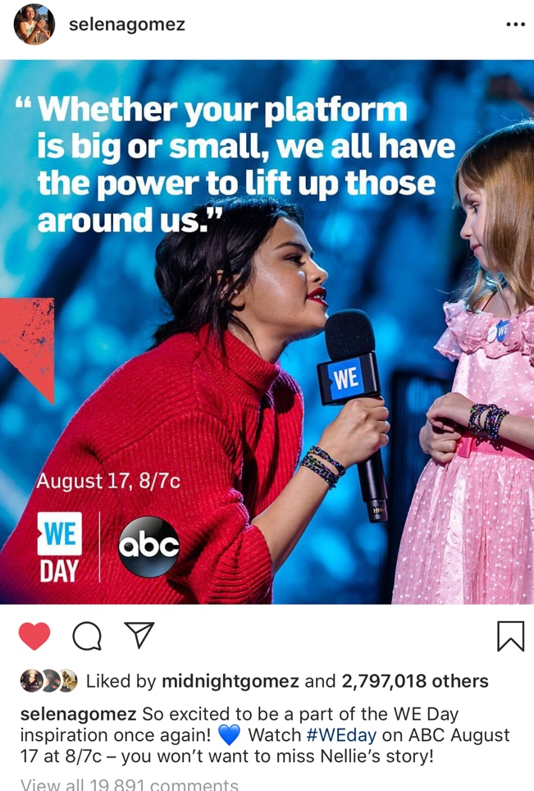
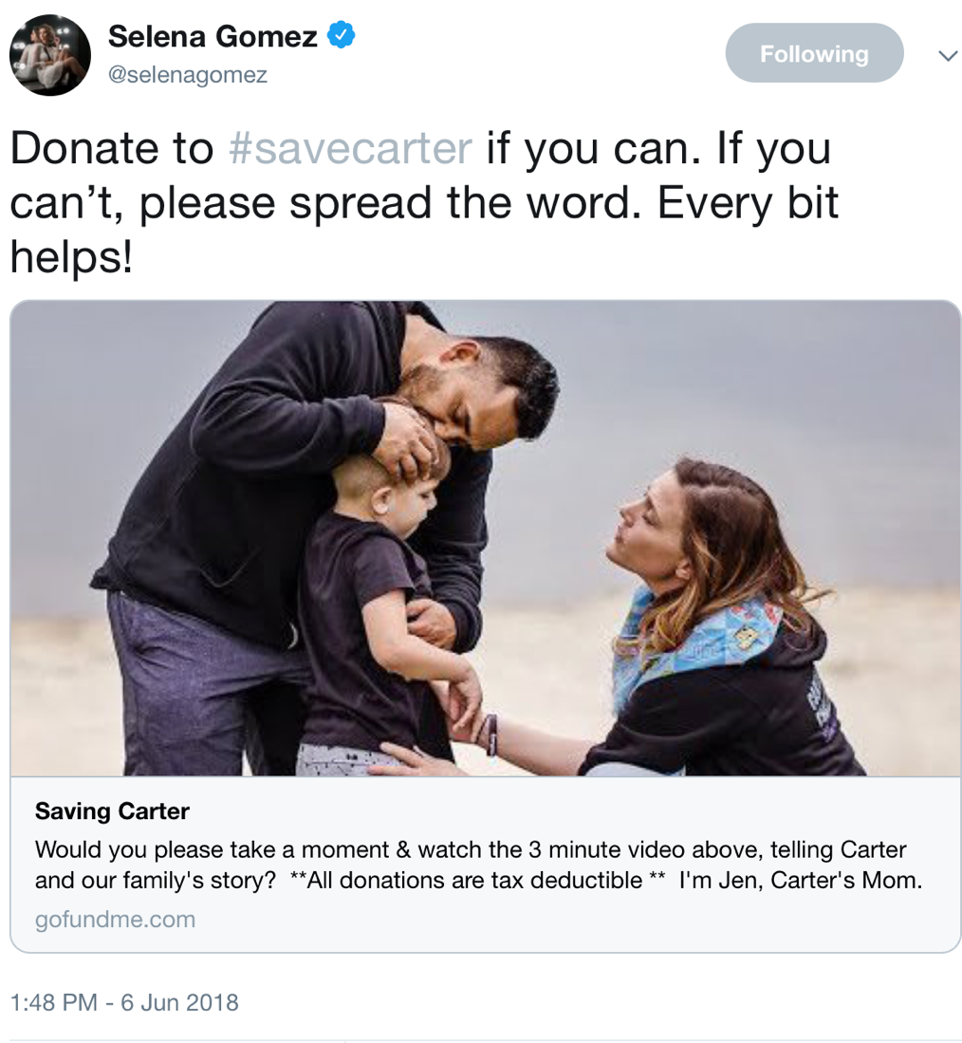
Vision for Change
Selena has many passions and concerns for the world. Her goal is to bring awareness to issues by using her platform and change the conversation being had, or lack there of, about these issues. She has on multiple occasions sent tweets to her 56.8 million twitter followers and shared pictures with her 144 million Instagram followers encouraging them to be aware of the issues going on around them. Often times she keeps her active work with organizations and causes behind the scenes and works as an advocate more publicly on social media.

Slide 6
Issue Areas and Concerns
Selena Gomez has worked with several charities throughout her life starting at a young age. She was named the youngest UNICEF ambassador in the U.S. at age 19. Two areas of concern she focuses on today are Human Trafficking, and LUPUS research.
Other areas include: Abuse, AIDS & HIV, ALS, Animals, Cancer, Children, Education, Health, Peace, Physical Challenges, Poverty, Rape/ Sexual Abuse, Refugees, and Women
List of charities that Selena Gomez has worked with in her life:
10x10, A Day Made Better, Alliance for Children’s Rights, ALS Association, Cystic Fibrosis Foundation, Elton John AIDS Foundation, ENOUGH Project, Free the Children, Make a Wish, Malala Fund, Rosie’s Theater Kids, Ryan Seacrest Foundation, Stand Up to Cancer, St. Jude Children’s Research Hospital, Teen Cancer America, UNICEF, A21, Step Up with Coach

Slide 7
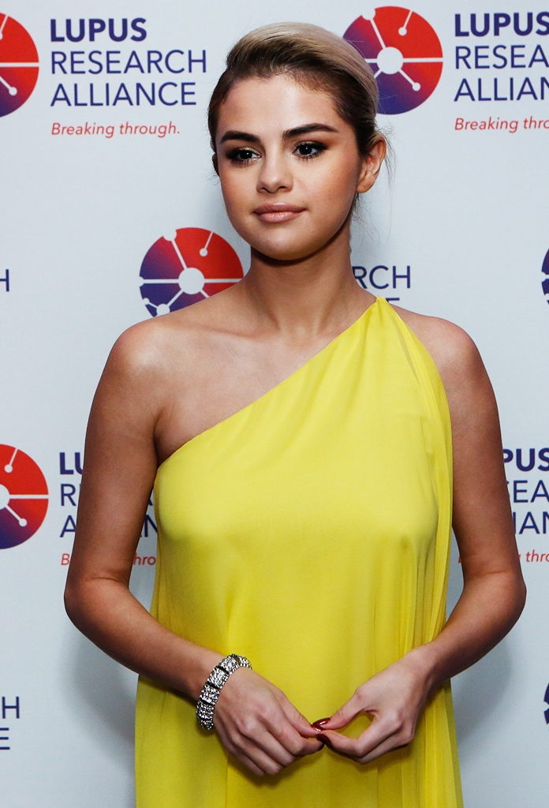
Lupus Research Gala
After releasing the news that she was battling with Lupus, Selena faced life or death and needed a kidney transplant. Luckily one of her best friends was a match. Since her recovery she has been active in speaking out about the auto immune disease and raised money for research through the Lupus Research Gala where she held the co-chair spot in November, 2017.
Billboard.com states that “This year's gala -- the largest single lupus fundraiser in the world -- raised more than $3.2 million, with every cent going directly to fund lupus research programs. Along with Gomez, the gala also honored NBCUniversal CEO Steve Burke, who announced that the media giant would be contributing $1 million to the organization.”

Slide 8
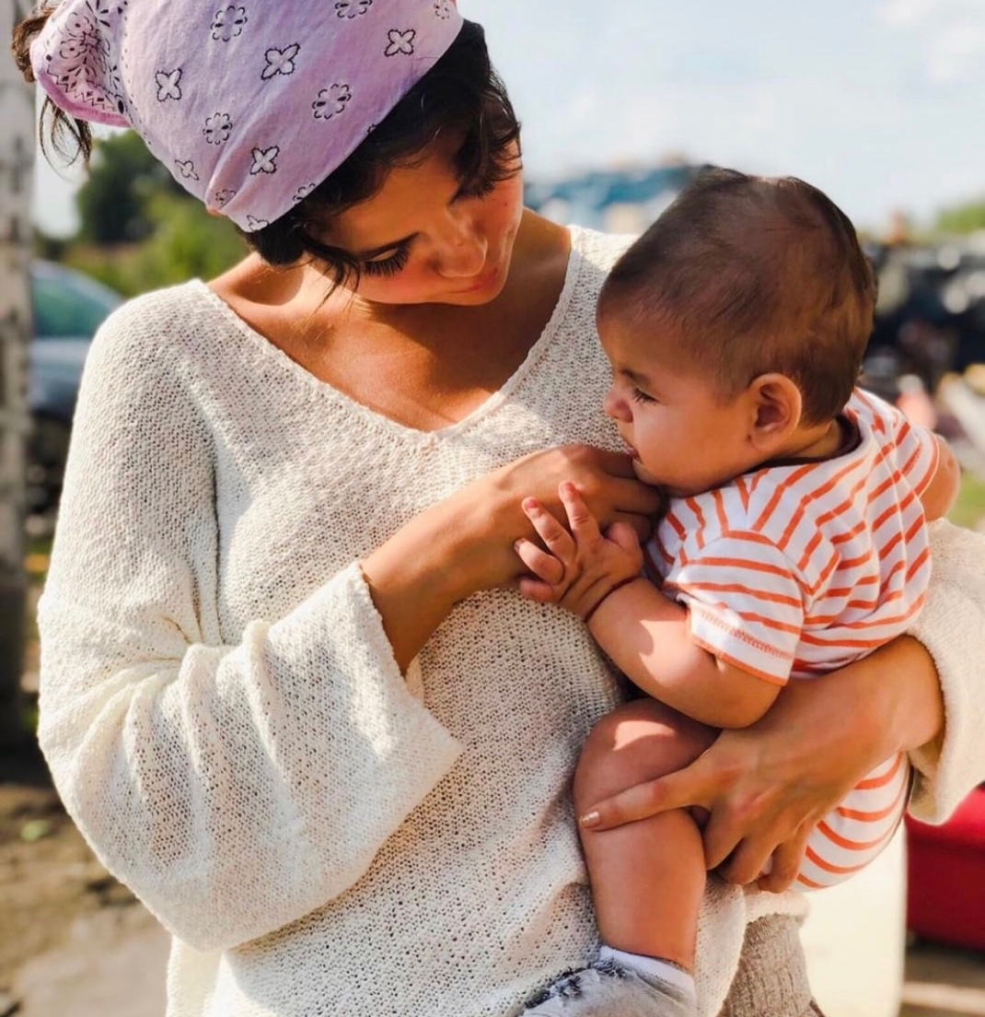

Internship with A21
Around September this year Selena did an interview with Elle magazine discussing how she was taking control of her own life. She wanted the focus of her interview to include her work with the A21 organization that works to stop human trafficking. In an Instagram post she states her work with A21 is “her heart”.
Selena has been interning and volunteering with A21 since March of 2018 and she works five times a week. In an article from Cosmopolitan magazine it states, “She feels so passionate about the cause to combat worldwide slavery that she goes out to do fieldwork and meets affected children and families. "The idea of human trafficking to me is…I'm flabbergasted," she said.”
Video from Selena’s internship posted on Instagram

Slide 9
Mission Statement:
“Charity, Action, Now!”
When Selena was first named UNCIEF’s youngest ambassador in the U.S. in 2009, she and her band joined the organization in saying that we C.A.N. make a difference.
On her first trip as an ambassador she traveled to Ghana in West Africa to see the work UNICEF has already begun to support the children in getting access to resources such as clean water, food, education, and medicine.
Ever since then, Selena has carried on this mission statement with her work with her other groups and organizations.

Slide 10
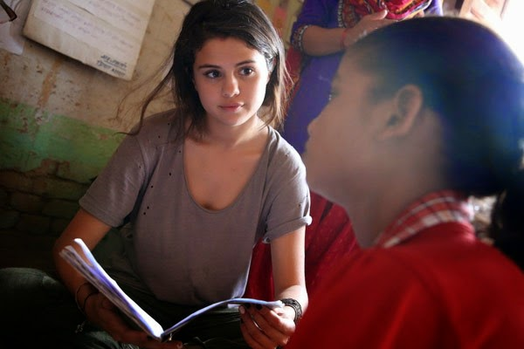
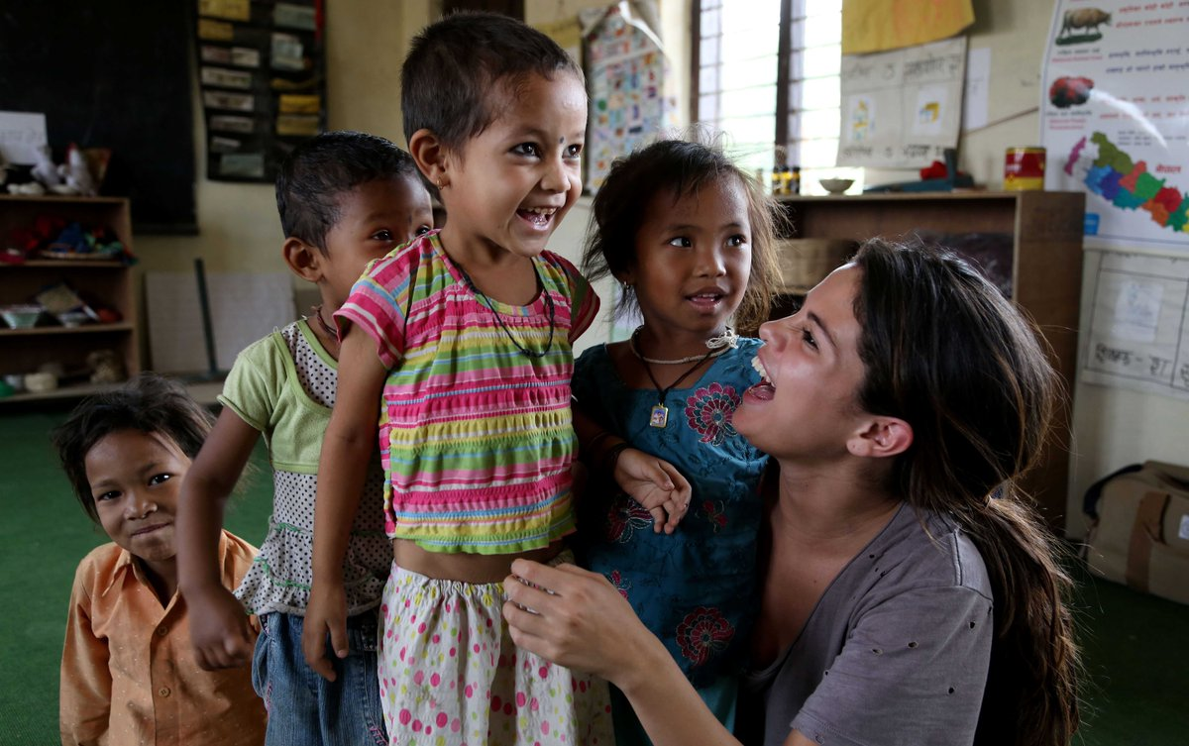
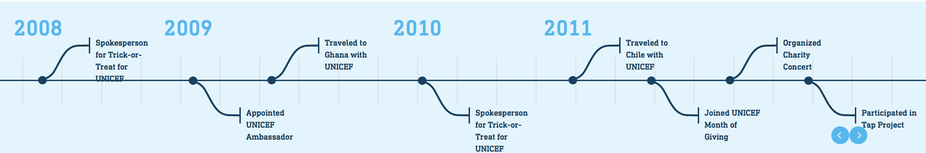
Four Pillars: Time and Trust
Selena Gomez has spent a lot of her time giving to others and being involved in philanthropic work, whether it be donating her time, money or energy.
As stated previously, her charitable work began with UNICEF in 2009 and since then she has worked with roughly eighteen other known charities and nonprofits.
When it comes to trust, she has no problem placing it in the hands of those who need it more than her. She can be described has a selfless person who gives more than she takes. She once stated in an interview that “I had been working for so long, and I don’t like taking things in my life. I just wanted to serve.” It’s easier for her to be vulnerable about those in need and trust in them which in turn benefits and reassures them that they can get the help they need.

Slide 11
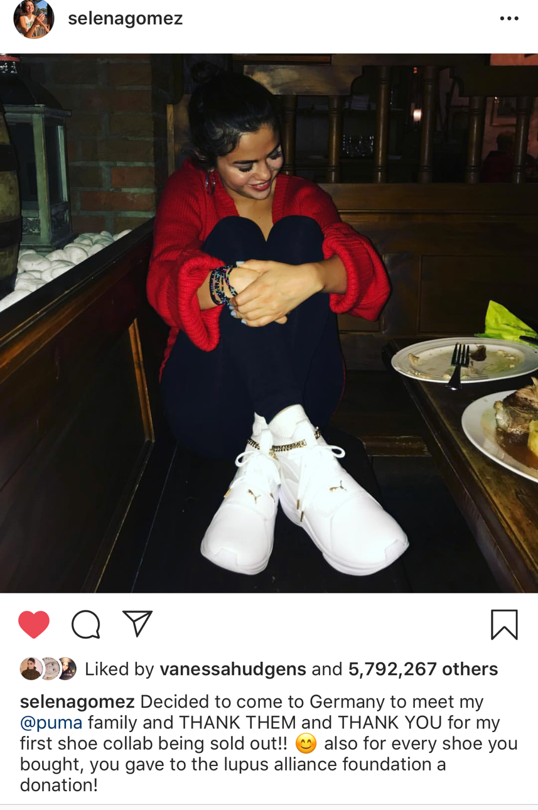
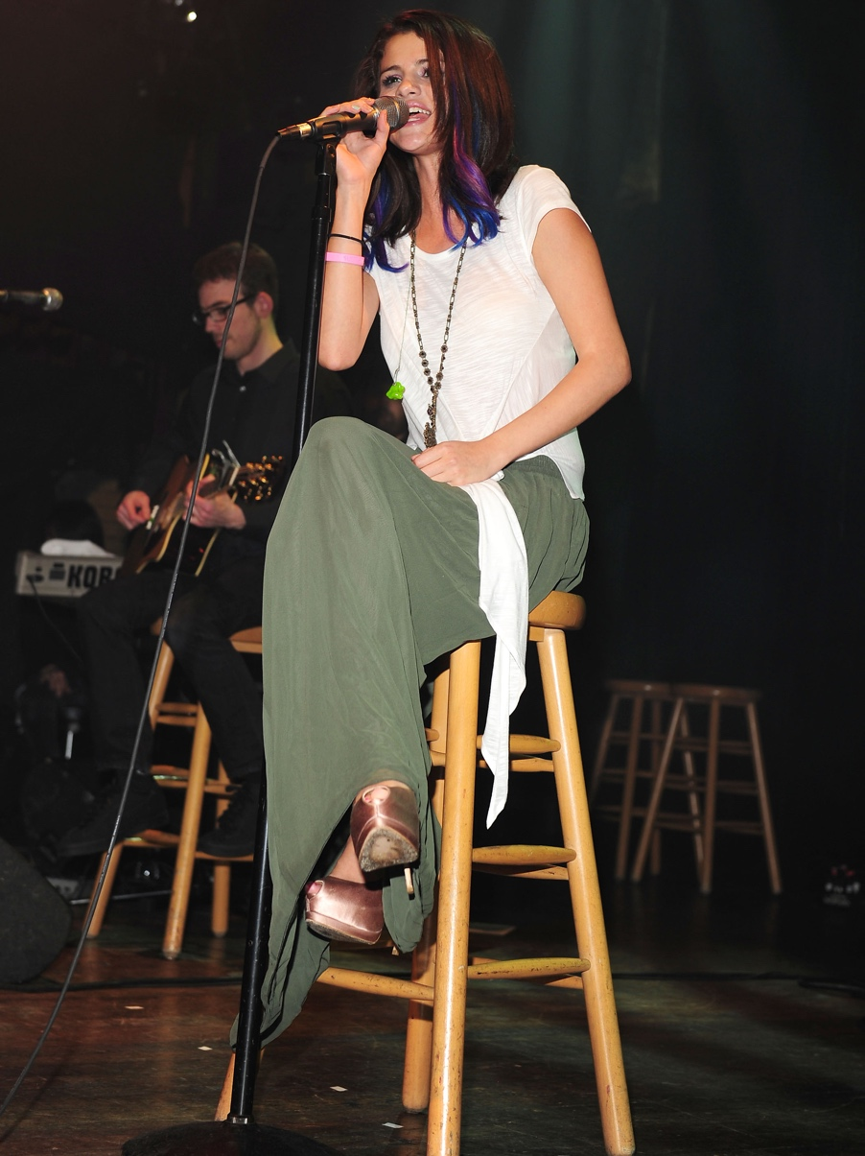

Four Pillars: Talent
Selena is a singer, actress, social media influencer, and holds many brand deals with large companies so she uses this to her benefit when it comes to philanthropic and nonprofit work.
In 2016,she donated proceeds proceeds from her Revival Tour to the Alliance for Lupus Research, and encouraged fans to donate to the organization through Instagram after her kidney transplant. In addition to this, she has held charity concerts that benefitted UNICEF that helped raise over $200,000.
Through social media, Selena raises awareness about issues such as human trafficking, Lupus and encourages her fans to become more aware of the dangers surrounding them. When it comes to her brand deals, she finds it fulfilling when she can work with companies like Coach who give her opportunities to mentor to girls through the Step Up program and Puma who give contribution to the Lupus Alliance Foundation through purchases.

Slide 12
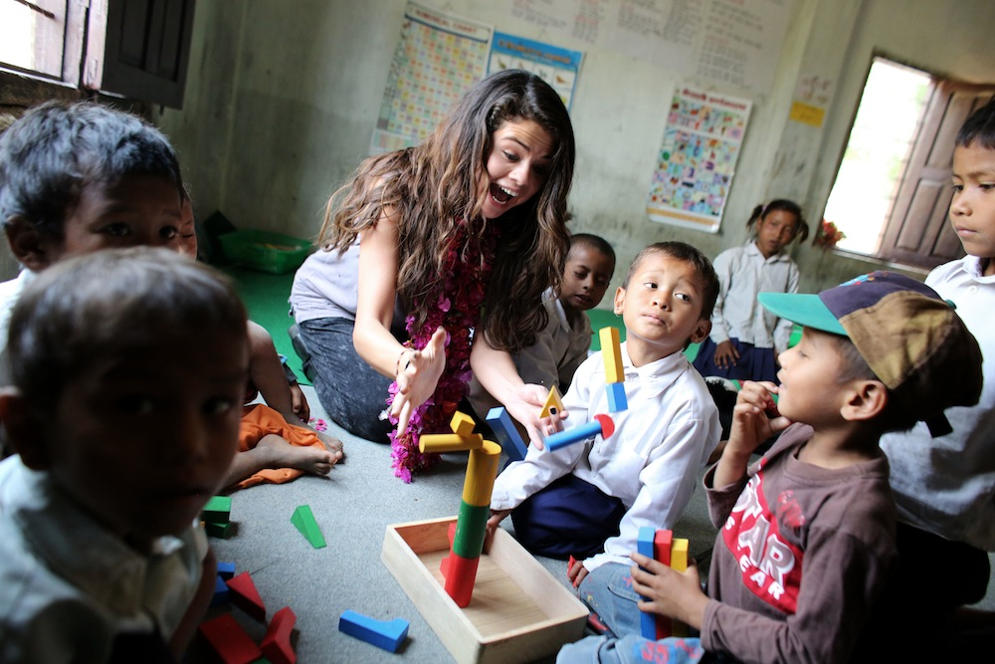
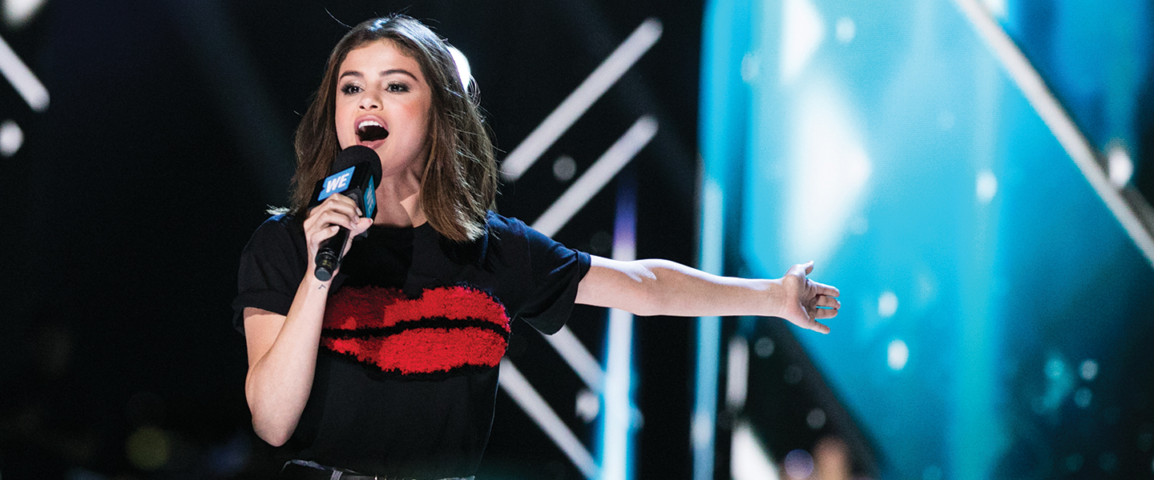
Four Pillars: Treasure
As mentioned before, Selena exemplifies time, trust, and talents in her philanthropic work. When it comes to what treasures she can bring to the table she has plenty to offer.
Because she is well off in many ways and she is in the music and movie industry she knows several people that would be willing to help organizations and nonprofits.
She is also great at motivating people, especially when it comes to children.
She is Latina and can speak Spanish so she would likely be able to help break through language barriers as well.
Lastly, she has spoken publicly several times and is very passionate when doing so; therefore, she would be the perfect spokesperson for any organization.

Slide 13
Selena’s Impact
While there is no definite number to represent how much money Selena Gomez has donated in her life thus far or how much she plans on donating, it has been found that she helped raised over $500,000 for the Lupus Research Alliance. After she agreed to work with director Woody Allen, she received quite a bit of hate for it. Because of this she donated more money to Times Up than she received for her film.
Selena isn’t very vocal about monetary donations that she makes, but as shown previously she has impacted the lives of children, women, and mankind all over the world through organizations like UNICEF, A21, and the Lupus Research Alliance to name a few.
Giving back and changing the conversation about difficult subjects is something that Selena has never been ashamed of and something tells me she won’t be stopping any time soon. Her work with these organization will continue on for years to come and will remain a part of her legacy.

Slide 14


What Can She Teach Others? What Has She Taught Me?
Selena Gomez doesn’t let negativity in the world change her giving habits. When tough times arise that’s when she knows she’s needed most which is something I would like to work into my legacy. She has clearly defined her areas of concerns and is very vocal about them. I believe the key is that she is unashamed of her beliefs and values. Because of this she is able to be as unapologetically herself as she wants to be. In return she can speak about things such as Human Trafficking, Human Rights, Women Rights, and Children and bring awareness to these areas of concerns. This is incredibly important to achieve as a philanthropist. Above all else, Selena puts others above herself whenever she can which is an attribute I consider to be philanthropic. I have admired Selena for years and all the hard work she has put in with several charities and nonprofit organizations. My hope is that others around the world are as inspired as I have been so that we can make a change together.

Slide 15
Works Cited
https://www.looktothestars.org/celebrity/selena-gomez#charities
https://www.etonline.com/selena-gomez-discusses-the-real-purpose-of-her-recent-interview-109018
https://www.unicefusa.org/supporters/celebrities/ambassadors/selena-gomez
https://www.billboard.com/articles/columns/pop/8039667/selena-gomez-lupus-gala-kidney-transplant-speech
http://armyofselenagomez.com/charity/
https://www.wmagazine.com/story/selena-gomez-coach-mentor-high-school-students
https://people.com/music/selena-gomez-best-ive-ever-been-social-media-hiatus/
https://www.elitedaily.com/life/selena-reinvent-yourself/1224533
https://www.cosmopolitan.com/entertainment/celebs/a22998173/selena-gomez-a21-internship/
http://selenagomez.wikia.com/wiki/Philanthropy
https://www.entitymag.com/how-much-is-selena-gomez-worth/
https://www.eonline.com/news/880340/selena-gomez-helps-raise-almost-500-000-for-lupus-research-alliance
https://www.bustle.com/p/selena-gomez-donated-more-money-to-times-up-than-she-received-for-her-woody-allen-movie-report-7927159

